Slide 1


Safety and Health Forum
AEDs
First Aid
Safety Committees

Slide 2
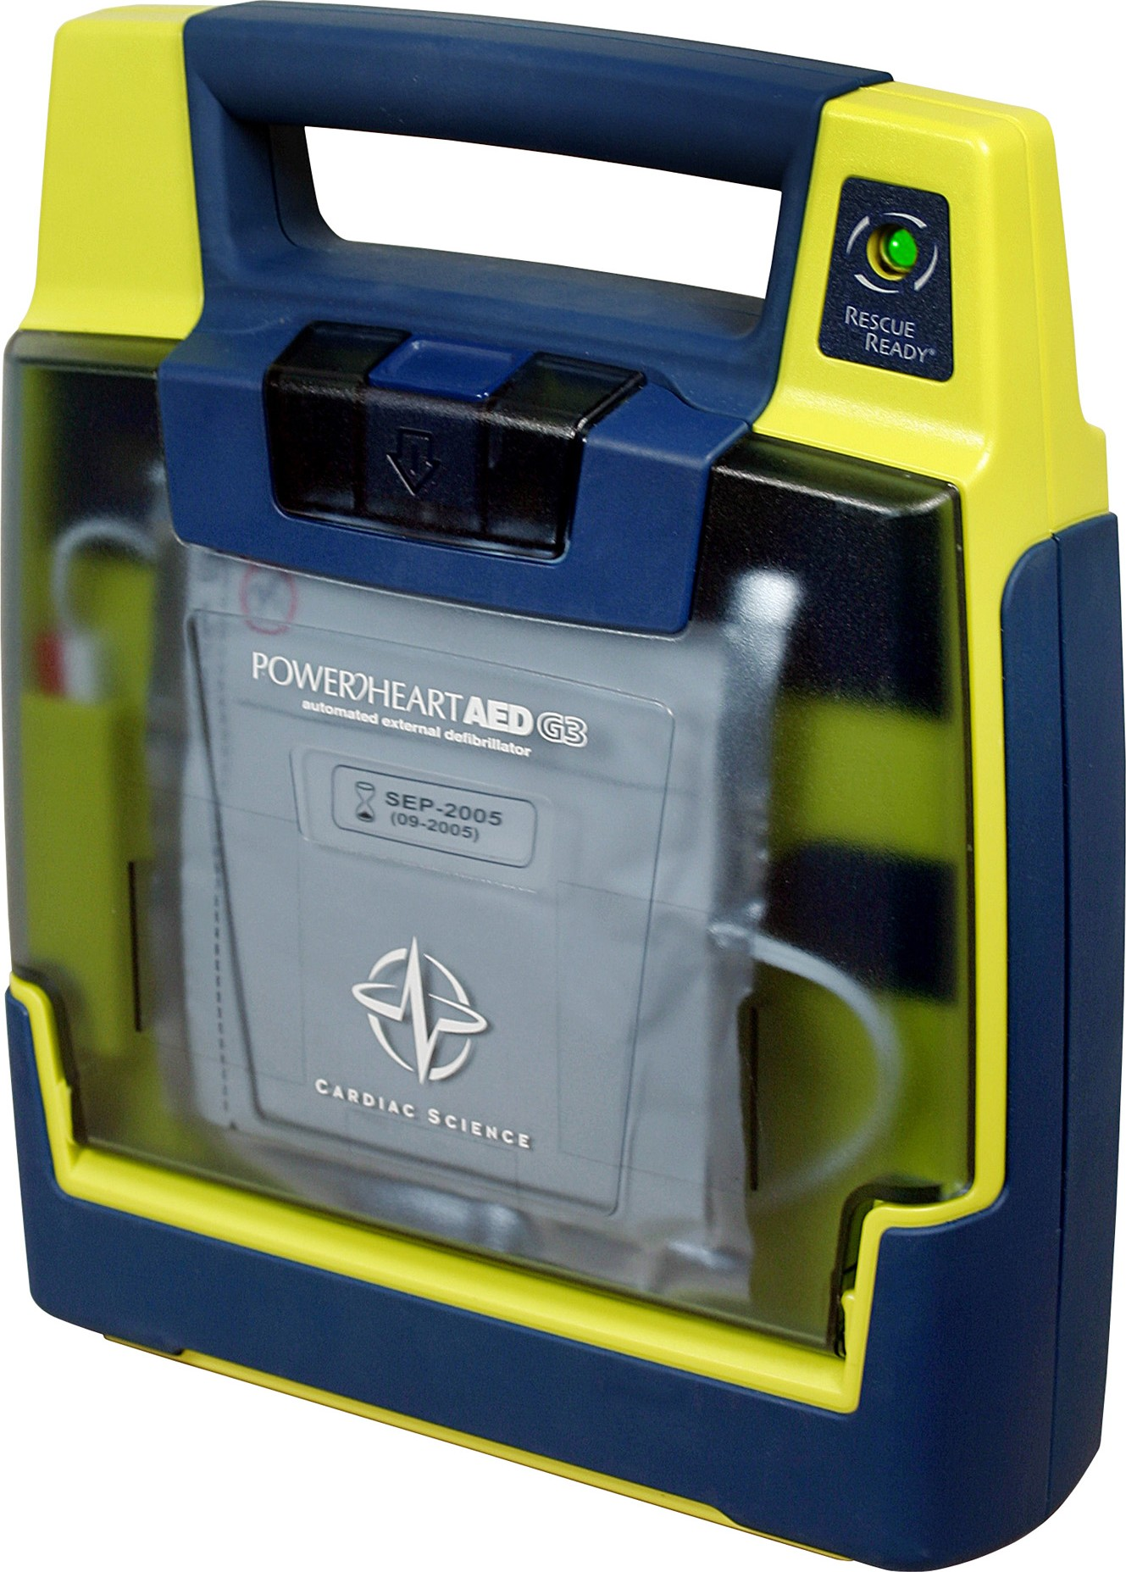
Automated External Defibrillator (AED)
Applicable Regulations
Responsibilities and Procedures
Training

Slide 3

Applicable Regulations
Currently no OSHA requirements
Regulations vary from State to State
WV AED regulations §16-4D-1

Slide 4
EHS responsibilities
Assist with AED selection and placement
Document and maintain AED locations
Coordinate AED training
Track recordkeeping data
Maintain and update AED program as necessary

Slide 5

Medical Director Responsibilities
Sign registration application
Review each AED Patient Contact Form
Send completed Patient Contact Form to Regional EMS Field Office

Slide 6

AED Program Coordinator
Assigned by Building Supervisor or Equivalent
Oversees the Building/Department AEDs
Coordinate training with EHS
Ensure EMS integration
Develop AED deployment strategies

Slide 7
Coordinator Responsibilities
Complete WV AED registration forms
Place AED in accessible locations
Ensure proper signage
Coordinate training with EHS
Ensure AED is in proper working order
Maintain AED

Slide 8
Coordinator Responsibilities
After AED use
  Notify
    Medical Director
    EHS
    UPD
  Complete and submit AED Patient Contact Form
  Follow manufacturer’s recommendations for servicing AED after use

Slide 9
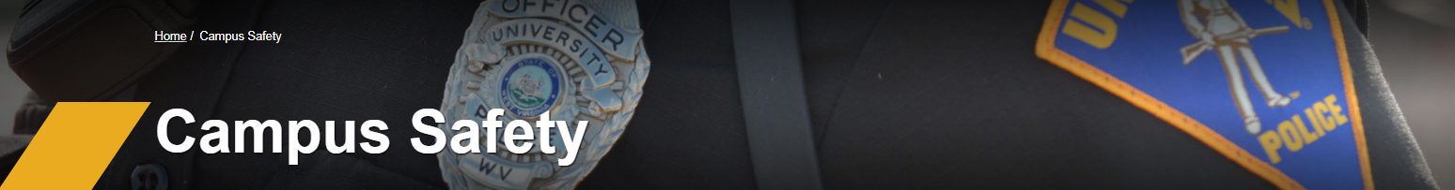
UPD Responsibilities
Emergency Response
AED Capabilities and Assistance
AED Technical review

Slide 10
Questions?
Thank You
EHS.WVU.EDU

Slide 11

First Aid
Training Requirements
Departmental responsibilities
First Aid Kits

Slide 12
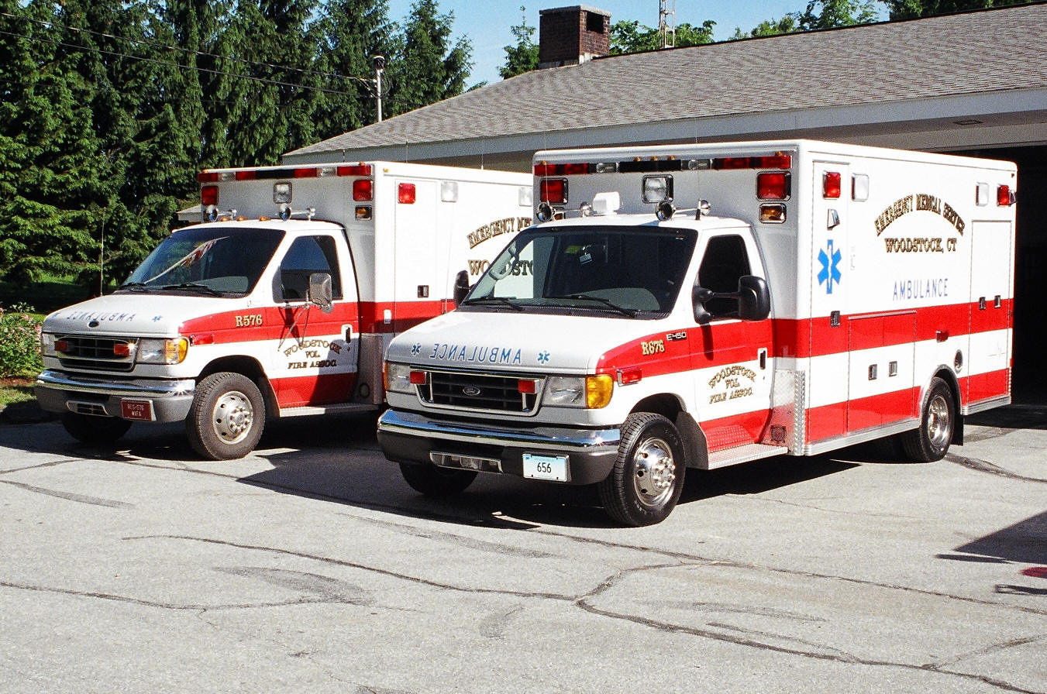
Are Departments required to have first aid responders?
That depends
  OSHA requires first-aid providers at workplaces if there is no infirmary, clinic or hospital in near proximity to the workplace

Slide 13

Near Proximity
  3 to 4 minute response time in areas where serious accidents are possible
  Up to 15 minutes where serious work-related injuries are less likely

Slide 14
EHS Responsibilities
Develop, maintain & review program
Provide guidance
Provide First Aid and Bloodborne Pathogens training
Maintain training records

Slide 15
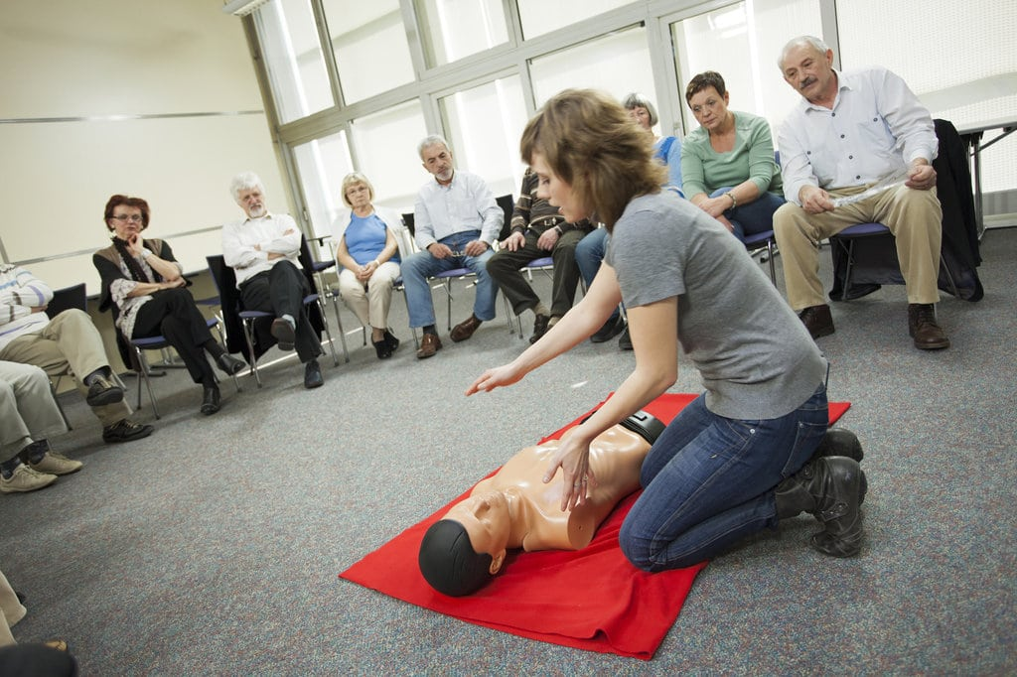
Training
First Aid training schedule can be found on EHS website https://www.ehs.wvu.edu/
  Offered Monthly
  Free for WVU employees
Bloodborne Pathogen (BBP) training
  Contact EHS to Schedule
  Hepatitis B Vaccine

Slide 16
Department Responsibilities
Identify personnel to attend first aid training
Provide first aid kits in designated areas
  Must be accessible
  Inspect and replace content as needed
  Notify employees of locations
Know emergency response agency contact numbers

Slide 17
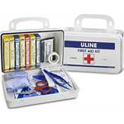
First Aid Kits contents
Absorbent Compress
Band-Aids
Bandage Scissors
Blanket
Cotton
Gauze pads
Ice Pack
Medical Gloves
Medical Tape
Moist Towelettes
Roller Gauze
Triangular Bandages
Gauze Bandages
Aspirin
Antihistamines
Antibiotic Topical Treatment

Slide 18
Questions?
Thank You
EHS.WVU.EDU

Slide 19

Building Safety Committees

Slide 20
Background
    There is no federal requirements to have building safety committees
    Many states are given incentives to establish building safety committees
    WV State Board of Risk and Insurance Management are requesting WVU to have building safety committees.
      Reduction in insurance premiums
      July submit meeting minutes to EHS

Slide 21
Purpose
  Our occupants are critical and have a vision
  Identify, and report any risks/hazards
  Be a conduit to:
      convey concerns to appropriate persons
      communicate with occupants in the building, and assist to correct issues
      Participate during building inspections with EHS, SFM, and BRIM

Slide 22

Who sits on the Committee
  Building Supervisor
  A representative from various departments
  Chemical Hygiene Officer
  Student
  EHS
  UPD

Slide 23

How is Committee Established
  Building Supervisor request to Dean/Director
  Dean/Director appoints
  Recruit others
  Contact EHS and UPD to assist

Slide 24
Types of Safety Committees
(Based on Building Occupancy and Activities)
  Business – ex: 1WP, B&E
  Housing & Student Support – ex: Lincoln Hall, Stalnaker Hall, Mt. Lair, Crossing Building
  Science - ex: Chemistry, ESB
  Farms & Industrial - ex: CAFEE
  Multi-Use – ex: HSC, Jackson’s Mill

Slide 25
Building Safety Committee
All Safety Committee Activities Include:
Identify chairperson
Develop goals and objectives
Schedule Safety committee Meetings
  2XAnnual to Monthly-Agenda Form (see packet)
  Share Meeting notes July 1 annually-EHS
Use resources - EHS/UPD
Develop BEP (Building Emergency Plan)-UPD assisted-recorded
  Coordinate emergency drills

Slide 26
All Building Safety Committees
  Develop and implement Building Emergency Plan (BEP) to building occupants
  Coordinate emergency & fire drills
  Identify training needs of occupants
  Report Injuries/Illness/Near Misses to EHS
  Review and address BRIM/SFM items submitted
  Submit meeting minutes to EHS at the end of year
    Safety committee meeting form (review)

Slide 27

Science - Safety Committees
  Assist and support CHO’s
  If possible monitor the use and disposal of chemicals
  Make building employees exposed to chemical or infectious materials aware of:
    Medical consultation, medical care and medical attention
    EHS for support, services and assistance

Slide 28

Student Support & Housing
Safety Committees
  Identify specialized training needs for (RA’s, RHC’s)
  Conduct fire drills twice per year
  Coordinate with EHS if malicious disturbances of Life Safety Systems occur

Slide 29
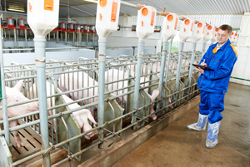

Farm & Industrial - Safety Committees
  Specialized training needs
  Coordinate with EHS if special needs/services are needed

Slide 30

Collaboration is Key
UPD
EHS
BSC

Slide 31
Recap and Take aways
AEDS
  Program
  Availability
  Management requirements
First Aid
  Kits
  Training
Safety Committee
  Purpose
  Membership
  Resources

Slide 32
Questions?
Thank You
EHS.WVU.EDU

